Slide 1





CSP 571 – Project Group 48
Classifying Histopathological Images of Lung cancer
Henrique Magalhaes Rio – A20544694
Riyaz Ahmed mohammed – a20547233

Slide 2
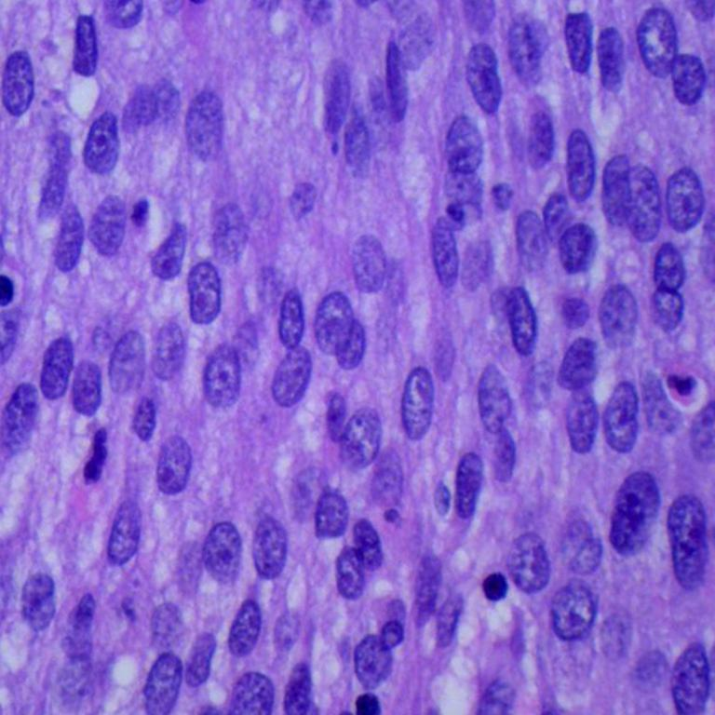
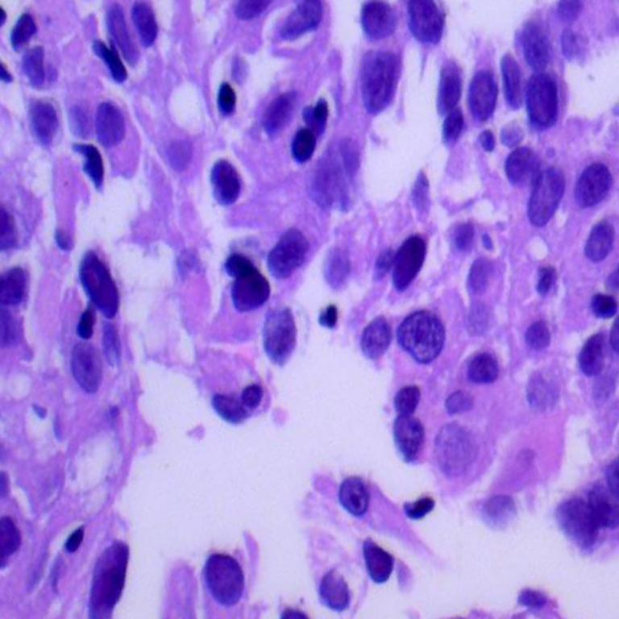
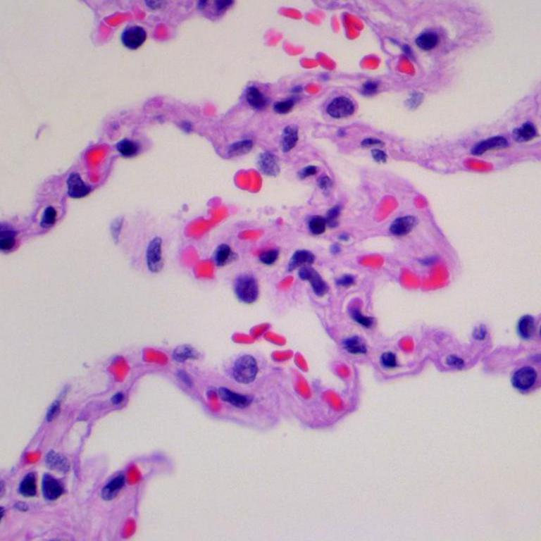
Dataset
Squamous Cell Carcinoma
Adenocarcinoma
The dataset consists of 15000 histopathological images of lung tissue
Images are 768x768 Pixels
It is divided in 3 classes
Benign Tissue
Adenocarcinoma
Squamous Cell Carcinoma
Benign tissue

Slide 3


Data Preparation
We start with the Images of the format $I_{768x768}$
Then for each Image load
Resize to 64x64 to get $R_{64x64}$
We grayscale the images to remove the RGB channel
We use np.flatten() the image $R_{64x64}$to get an array $x_{4096}$
Add the $x_{4096}$ to the dataset X
We end up with a dataset that $X_{nx4096}$ where n is the total number of images and an array $y_{4096x1}$
For testing we also separated the dataset as 80% Training, 20% Validation and 20% Testing

Slide 4
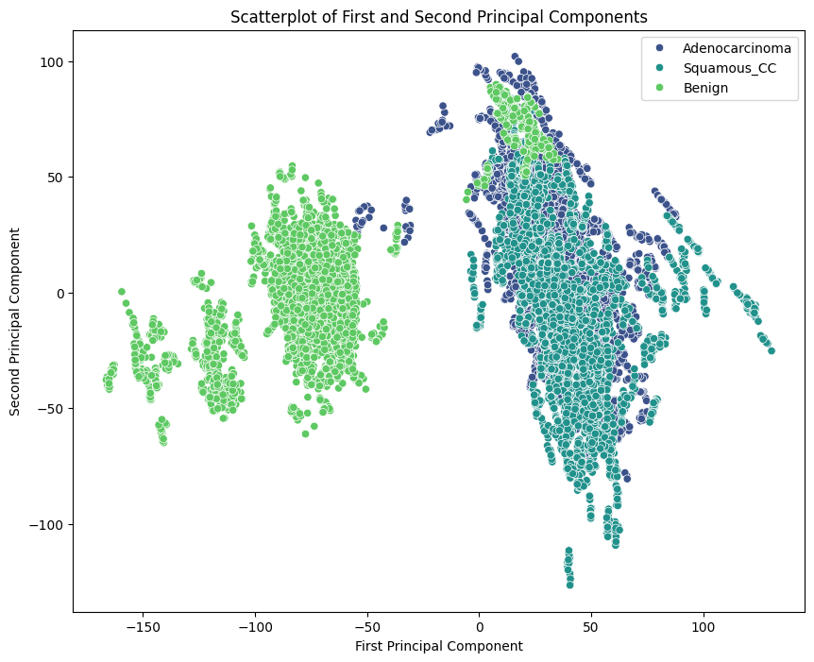
To reduce the dimensions and complexity we used PCA
RGB Images
We first tried using the RGB images instead of grayscale.
The plot represents the first 2 principal component of the RGB images
Clean separation between Cancer and No Cancer

Slide 5
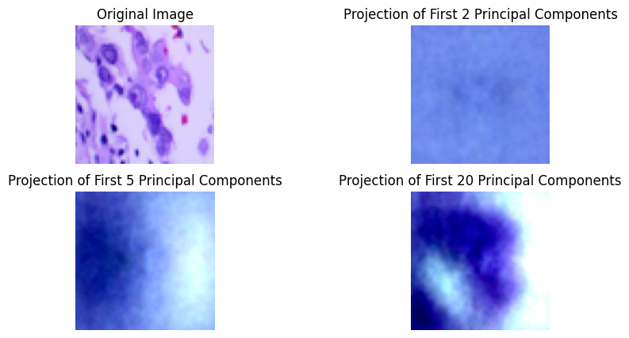
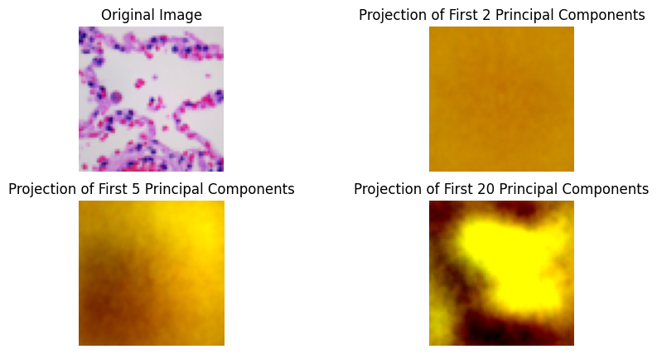
Why Grayscale?
Cancerous
Cancerous cells are diagnosed based on the structure not the coloring
Color changes according to the process of obtaining the images and is not indicative of cancerous cells
We can visualize using the inverse transform to project the principal components
Benign

Slide 6
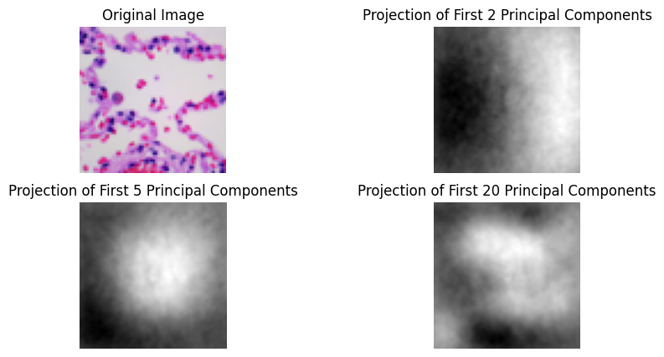
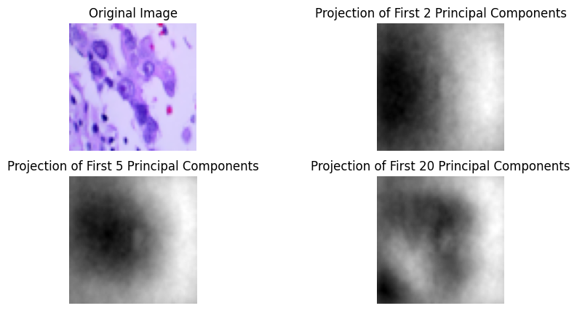
Grayscale Images projection
Cancerous
Benign

Slide 7
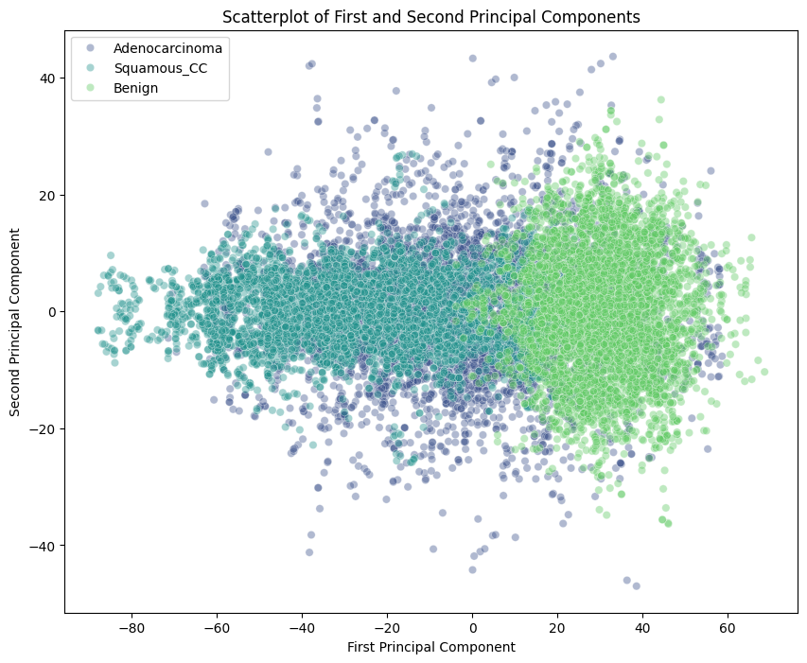
PCA of Grayscale Images
Here we do the PCA on the full Image data set.
Each point represents an image with the dimension reduced to 2 principal components.
The dimension reduction makes it easier to visualize and can help with the curse of dimensionality

Slide 8
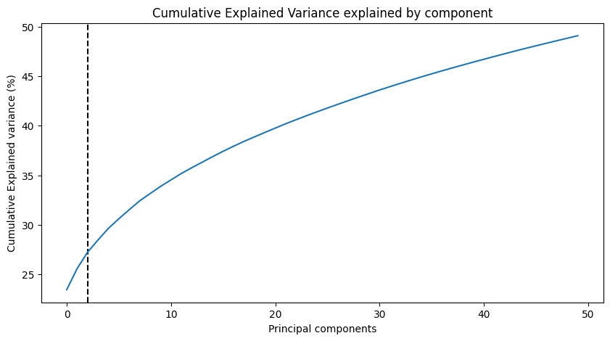
Cumulative Variance explained by the PCA

Slide 9
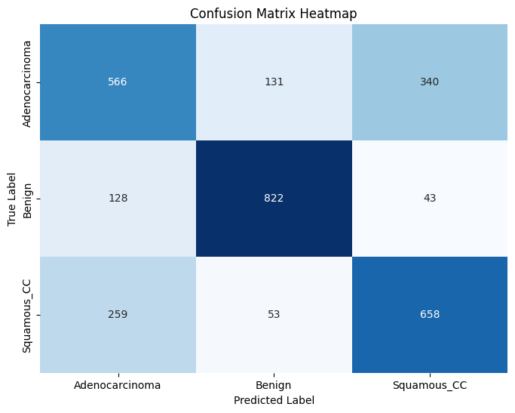
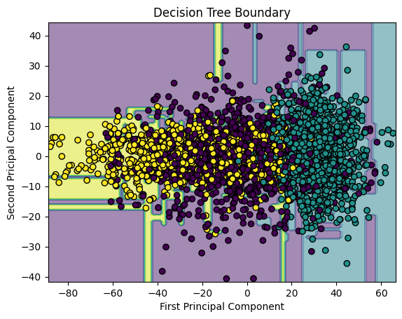
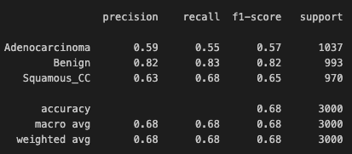

Decision Tree
Decent precision but lacking in overall accuracy
$Precision=\frac{TP}{TP+FP}$

Slide 10
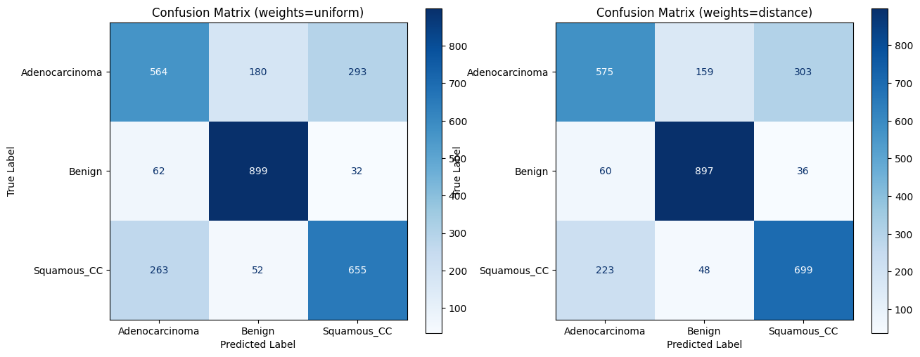
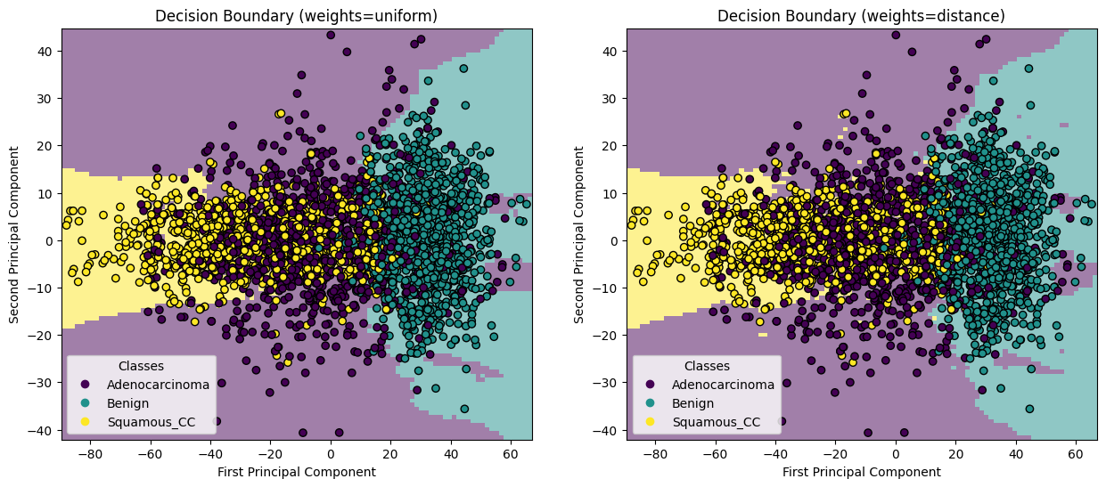
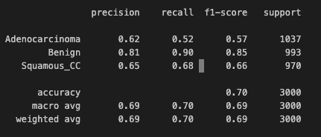
KNN Results
Based on the validation set accuracy, we choose K = 16
Improved overall accuracy when compared to decision trees
Report for Uniform weights

Slide 11
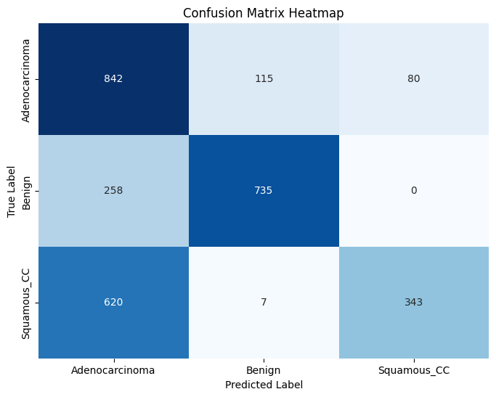
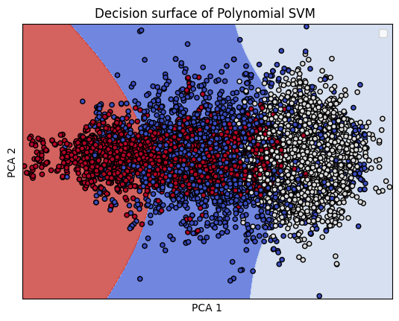
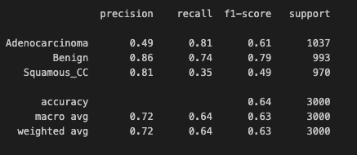
Support Vector Machine
We used a SVM model with a polynomial kernel
Accuracy is lower than KNN but precision is higher

Slide 12
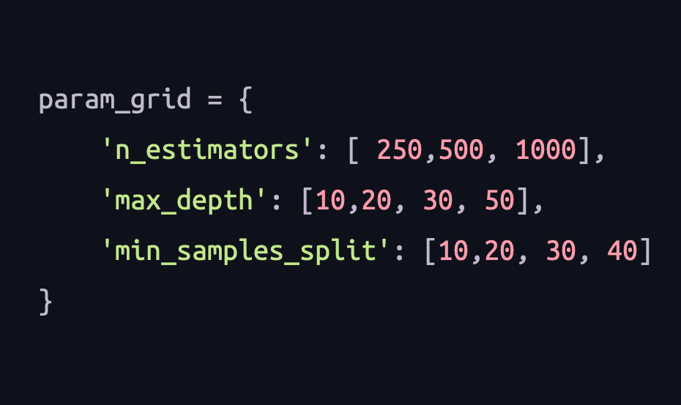
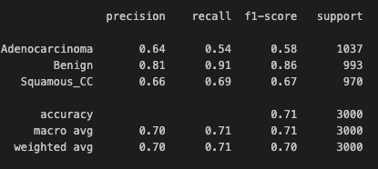
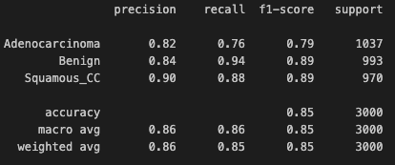
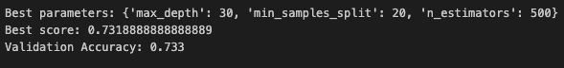
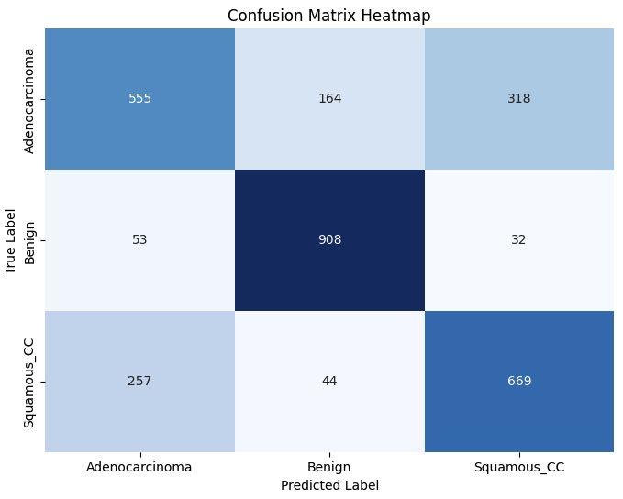
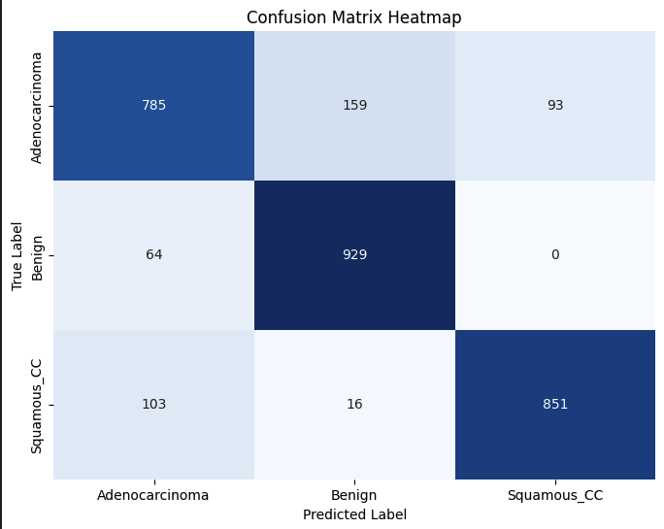
Random Forest Models
2 Principal Components
50 Principal Components
Increasing the number of principal components, increased overall accuracy, but the precision is still worse then SVM

Slide 13
Conclusion
DT
KNN
SVM
RF

Slide 14
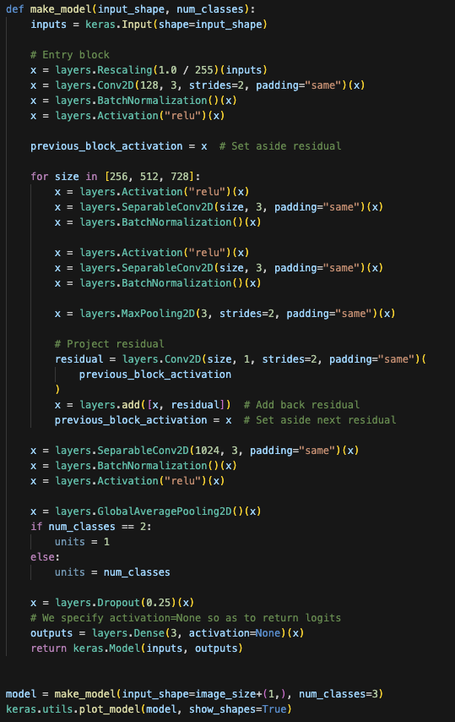
Future Work
More complex models for classification such as neural networks.
Training is a lot more complex, model is overfitting

Slide 15
Citation
Dataset
https://www.kaggle.com/datasets/andrewmvd/lung-and-colon-cancer-histopathological-images
Scikit-learn: Machine Learning in Python, Pedregosa et al., JMLR 12, pp. 2825-2830, 2011.

